Slide 1
Introduction to Operating Systems
CPSC/ECE 3220 Spring 2020
Lecture Notes
OSPP Chapter 3
(adapted by Mark Smotherman from Tom Anderson’s slides on OSPP web site)

Slide 2
OS Design Questions
What functions should the OS provide?
Where should this functionality be located?
In a user-level program?
In library routines linked with the application?
In the kernel?
In a standalone server process?
Servers typically run in user mode
Note that clients and servers will need to make kernel calls to communicate

Slide 3
Tradeoffs
Functionality outside the kernel
Easier to change without breaking the system call interface
Less likely to have buggy code in the kernel that corrupts kernel or user data
Functionality inside the kernel
Better protection because validity checks cannot be skipped
Better performance since fewer system calls are needed

Slide 4
Each system call can be limited in functionality. Provides primitives that you can “mix and match”.
“thin waist”

Slide 5
UNIX Case Study
Creating and managing processes
fork(), exec(), wait()
Performing I/O
open(), read(), write(), close()
Communicating between processes
pipe(), dup2(), select(), connect()

Slide 6
UNIX Process Management
UNIX fork() – system call to create a copy of the current process, and start it running
UNIX exec() – system call to change the program being run by the current process
UNIX wait() – system call to wait for a process to finish
UNIX signal() – system call to send a notification to another process
Notes:
UNIX splits creating a process into two steps, each of them a lot simpler.

Slide 7
UNIX fork()
#include <sys/types.h> #include <unistd.h>
pid_t fork(void);
Creates a duplicate of parent process
Child and parent have unique process ids (PIDs)
Run in separate memory spaces, with identical content at time of fork()
Takes no arguments!
Returns twice!!!
Parent gets his child’s pid
Child gets a zero
Notes:
UNIX splits creating a process into two steps, each of them a lot simpler.

Slide 8
Before fork()
parent process
PCB
text
data
heap
stack

Slide 9
After fork()
parent process return value is its child PID
child process exact copy with new PID and a return value of 0
PCB
PCB
text
text
data
data
heap
heap
stack
stack
child process

Slide 10
Implementing UNIX fork()
Create and initialize the process control block (PCB) in the kernel
Create a new address space
Initialize the address space with a copy of the entire contents of the address space of the parent
Inherit the execution context of the parent (e.g., any open files)
Inform the scheduler that the new process is ready to run

Slide 11
Question: What does this code print?
#include <stdio.h>
#include <sys/types.h>
#include <unistd.h>
int main()
{
printf(“Will attempt to fork now!\n\n”);
// make two process which run same
// program after this instruction
fork();
printf("Hello world!\n");
return 0;
}
Notes:
Parent could print first, or child could print first – you don’t know!

Slide 12
Question: What does this code print?
Output:
Will attempt to fork now
Hello World!
Hello World!
#include <stdio.h>
#include <sys/types.h>
#include <unistd.h>
int main()
{
printf(“Will attempt to fork now!\n\n”);
// make two process which run same
// program after this instruction
fork();
printf("Hello world!\n");
return 0;
}
Notes:
Parent could print first, or child could print first – you don’t know!

Slide 13
Question: What does this code print?
int ret_id = fork();
if (ret_id == 0) { // child process
printf("I am child process with id: %d\n", getpid());
} else { // parent process
printf("I am parent process of %d\n", ret_id); printf(“My own PID is %d\n”, getpid());
}
….
Notes:
Parent could print first, or child could print first – you don’t know!

Slide 14
Question: What does this code print?
#include <stdio.h>
#include <sys/types.h>
#include <unistd.h>
int main()
{
fork();
fork();
fork();
printf("hello\n");
return 0;
}
Notes:
Parent could print first, or child could print first – you don’t know!

Slide 15
Question: What does this code print?
#include <stdio.h>
#include <sys/types.h>
#include <unistd.h>
int main()
{
fork();
fork();
fork();
printf("hello\n");
return 0;
}
hello
hello
hello
hello
hello
hello
hello
hello
Total Number of Processes = 2^{n}, where n is number of fork system calls. So here n = 3, 2³ = 8
Notes:
Parent could print first, or child could print first – you don’t know!

Slide 16
Fork Bomb
Be careful spawning processes with fork()
Program which harms a system by making it run out of memory – fork bomb.
while (1) fork();
A form of denial-of-service (DoS) attack against a Linux/Unix based system.
It may not be possible to resume normal operation without rebooting the system, as the only solution to a fork bomb is to destroy all instances of it.
Notes:
Parent could print first, or child could print first – you don’t know!

Slide 17
Question: What are the final values of x?
#include <stdio.h>
#include <unistd.h> …
int main(){
int child = fork();
int x = 5;
if( child == 0 ){
x += 5;
}else{
child = fork();
x += 10;
if( child ){
x += 5;
}
}
return 0;
}

Slide 18
Final values of x
#include <stdio.h>
#include <unistd.h>
int main(){
int child = fork();
int x = 5;
if( child == 0 ){
x += 5;
}else{
child = fork();
x += 10;
if( child ){
x += 5;
}
}
return 0;
}
// first child
int x = 5;
// if( child == 0 )
x += 5;
return 0;
// x is 10
// second child
x += 10;
return 0;
// x is 15
// parent
child = fork();
// parent
int x = 5;
// else
child = fork();
// x starts at 5
// on either path
// parent
x += 10;
// if( child )
x+=5;
return 0;
// x is 20
before first fork after first fork after second fork

Slide 19
Implementing UNIX exec()
Load the program into current address space
Copy arguments into memory in address space
Initialize the hardware context to start execution at “start”

Slide 20
The exec() family
The exec() family of functions replaces the current process image with a new process image.
It loads the program into the current process space and runs it from the entry point.
does NOT create a new process.

Slide 21
The exec() family
int execl(const char *path, const char *arg, ...);
int execlp(const char *file, const char *arg, ...);
int execle(const char *path, const char *arg, ..., char * const envp[]);
int execv(const char *path, char *const argv[]);
int execvp(const char *file, char *const argv[]);
int execvpe(const char *file, char *const argv[], char *const envp[]);
See manual for more info: http://man7.org/linux/man-pages/man3/exec.3.html

Slide 22
The exec() family
#include <stdio.h>
#include <stdlib.h>
void main(int argc, char *argv[]){
int i, limit;
if (argc == 1){
puts("Error");
exit(1);
}
limit = atoi(argv[1]);
for (i = 0; i <= limit; i++)
printf (" we have %d\n", i);
}
…
int main (int argc, char * argv[]){
if (fork() == 0) /* in child process */
execl ("./count", "count", argv[1], NULL);
else { /* in parent process */
printf ("In parent process \n");
}
wait (NULL);
printf ("In parent, child complete\n");
return 0;
}

Slide 23
UNIX Process Management
Notes:
How is this used – typically, fork a process, child and parent are now both running the same program. One sets up the child program, and runs exec – becoming the new program
The parent, usually, waits for the child to finish

Slide 24
Unix wait()
}
Pause parent until child finished, crashed, or is otherwise terminated.
Returns child id to the reaping parent
Man page: http://man7.org/linux/man-pages/man2/waitid.2.html
…..
int main()
{
pid_t cpid;
if (fork()== 0)
exit(0); /* terminate child */
else
cpid = wait (NULL); /* reaping parent */
printf("Parent pid = %d\n", getpid());
printf("Child pid = %d\n", cpid);
return 0;
}

Slide 25
UNIX I/O
Uniformity
All operations on files, I/O devices, and pipes use the same set of system calls: open(), close(), read(), write()
Open before use
Check permissions and set up internal housekeeping
open() returns a handle (file descriptor) for use in later calls on the file
Byte-oriented interface
All devices accessed with byte arrays
Kernel-buffered read() and write()
Explicit close()
- decrement reference counter and gc unused kernel DS

Slide 26
Interface Design Question
Why not separate system calls for open()/create()/exists()?
if (!exists(name))
create(name); // can create() fail?
fd = open(name); // does the file exist?

Slide 27
Atomic open in Unix
Test if file exists, optionally create it if it does not, then open it.
Open is uninterruptible with respect to other system calls.

Slide 28
Unix Pipe
Kernel buffer with 2 file descriptors
For writing to the pipe
For reading from the pipe
Open is uninterruptible with respect to other system calls.

Slide 29
Command Interpreter (“Shell”)
Interactive interface to OS system calls
Finds executable file associated with a command and creates a process (passing any parameters)
Typically extended as a mini-language (e.g., control structures, macros)
Shell scripts (“batch files” on Windows)
Start-up files (e.g., .cshrc) and environment variables (predefined macros)
Handles I/O redirection

Slide 30
Forms of Interprocess communication
Producer-consumer
Output of one program is input to another
One way: one writes, another reads at a different pace from the same pipe
Allows chaining
Client-Server
Two-way communication, two pipes
Client sends request, server performs the operation and replies to client
File System
Connect thru reading/writing files
Can be separated in time, so need persistent storage and file naming

Slide 31
Interprocess Communication (IPC) Using Pipes
Connect the I/O of two programs on the command line using a pipe (“|”)
Combine applications into complex structures

Slide 32
Client-Server IPC Using Pipes
Server process can wait on input from multiple client processes using select()

Slide 33
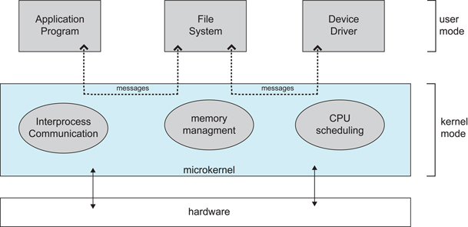
OS Structure Design Choice
Large kernel provides all or most system services
Sometimes called a “bloated kernel”
Microkernel provides minimal services
Other services provided by user-mode servers
Diagram 2.14 from Silberschatz, Galvin, and Gagne, OS concepts, 9th ed.

Slide 34
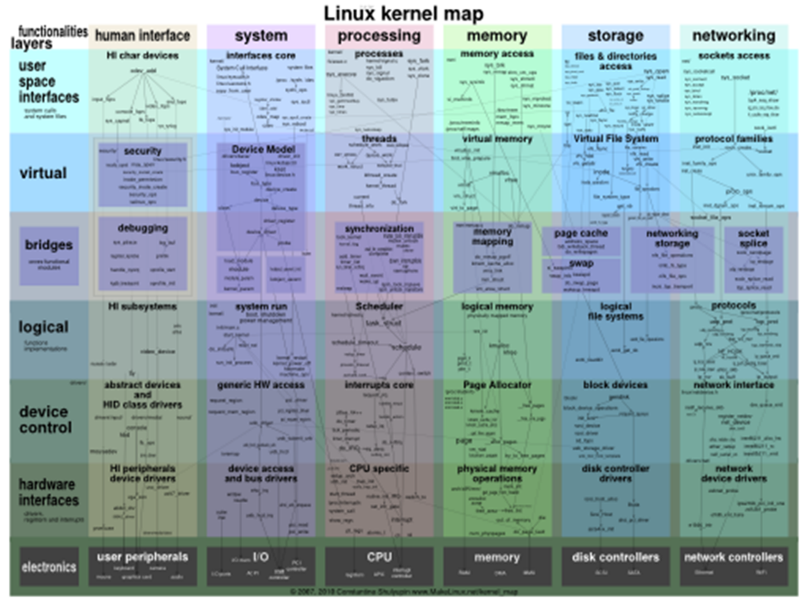
Diagram from http://www.makelinux.net/kernel_map/

Slide 35
Design Tradeoffs
Performance concerns
Procedure call to library routine is fastest
Kernel call is slower
Passing messages to a server process is slowest
Reliability concerns
Linux 4.11 has over 18M lines of code
half of which is reported to be device driver code
seL4 microkernel is 9,700 lines of C and 500 lines of assembler
but only implements interrupt handling, message passing, and scheduling; furthermore, it only runs on a limited number of platforms

Slide 36
Linus Shares His Opinion
I think microkernels are stupid. They push the problem space into *communication*, which is actually a much bigger and fundamental problem than the small problem they are purporting to fix. They also lead to horrible extra complexity as you then have to fight the microkernel model, and make up new ways to avoid the extra communication latencies etc.
from http://meta.slashdot.org/story/12/10/11/0030249/linus-torvalds-answers-your-questions

Slide 37
Typical OS Design Approaches
Hardware abstraction layer (HAL)
Portability across processors/hw platforms
Allows rest of OS to be written in a machine-independent manner
Loadable device drivers
“Plug and Play”
The kernel does not need to be recompiled to work with new I/O devices
Trend to make device drivers run in user mode

